Slide 1
From the Top Down
An Alternative
Furlough/Pay Cut
Plan for the UofA
CAJUA Finance Group, May 21, 2020

Slide 2
We call on
our leaders to demonstrate our shared values of integrity and compassion by taking on more of the financial burden of the pandemic and pre-existing budgetary crisis
for the next year
From the University of Arizona strategic plan

Slide 3
We propose a top-to-bottom model that establishes the floor for salary cuts at $7OK to protect the most vulnerable at the UofA from financial hardship.
The Administration Bottom Up proposal protects the most economically privileged group of UofA employees by capping cuts at 20% for those making $200K and above.

Slide 4
We call for
-A higher floor on the furlough/pay cut plan
-Larger and proportionate contributions from the most financially secure (a higher cap)
-Access to the data used to create the furlough/pay cut plan to keep improving it

Slide 5
Our top down furlough/pay cut plan would save*
$86,771,982. 92
*The salary data used for this analysis is the most recent available one, based on 1.0 FTE and a 12 months salary equivalent for academic employees.

Slide 6
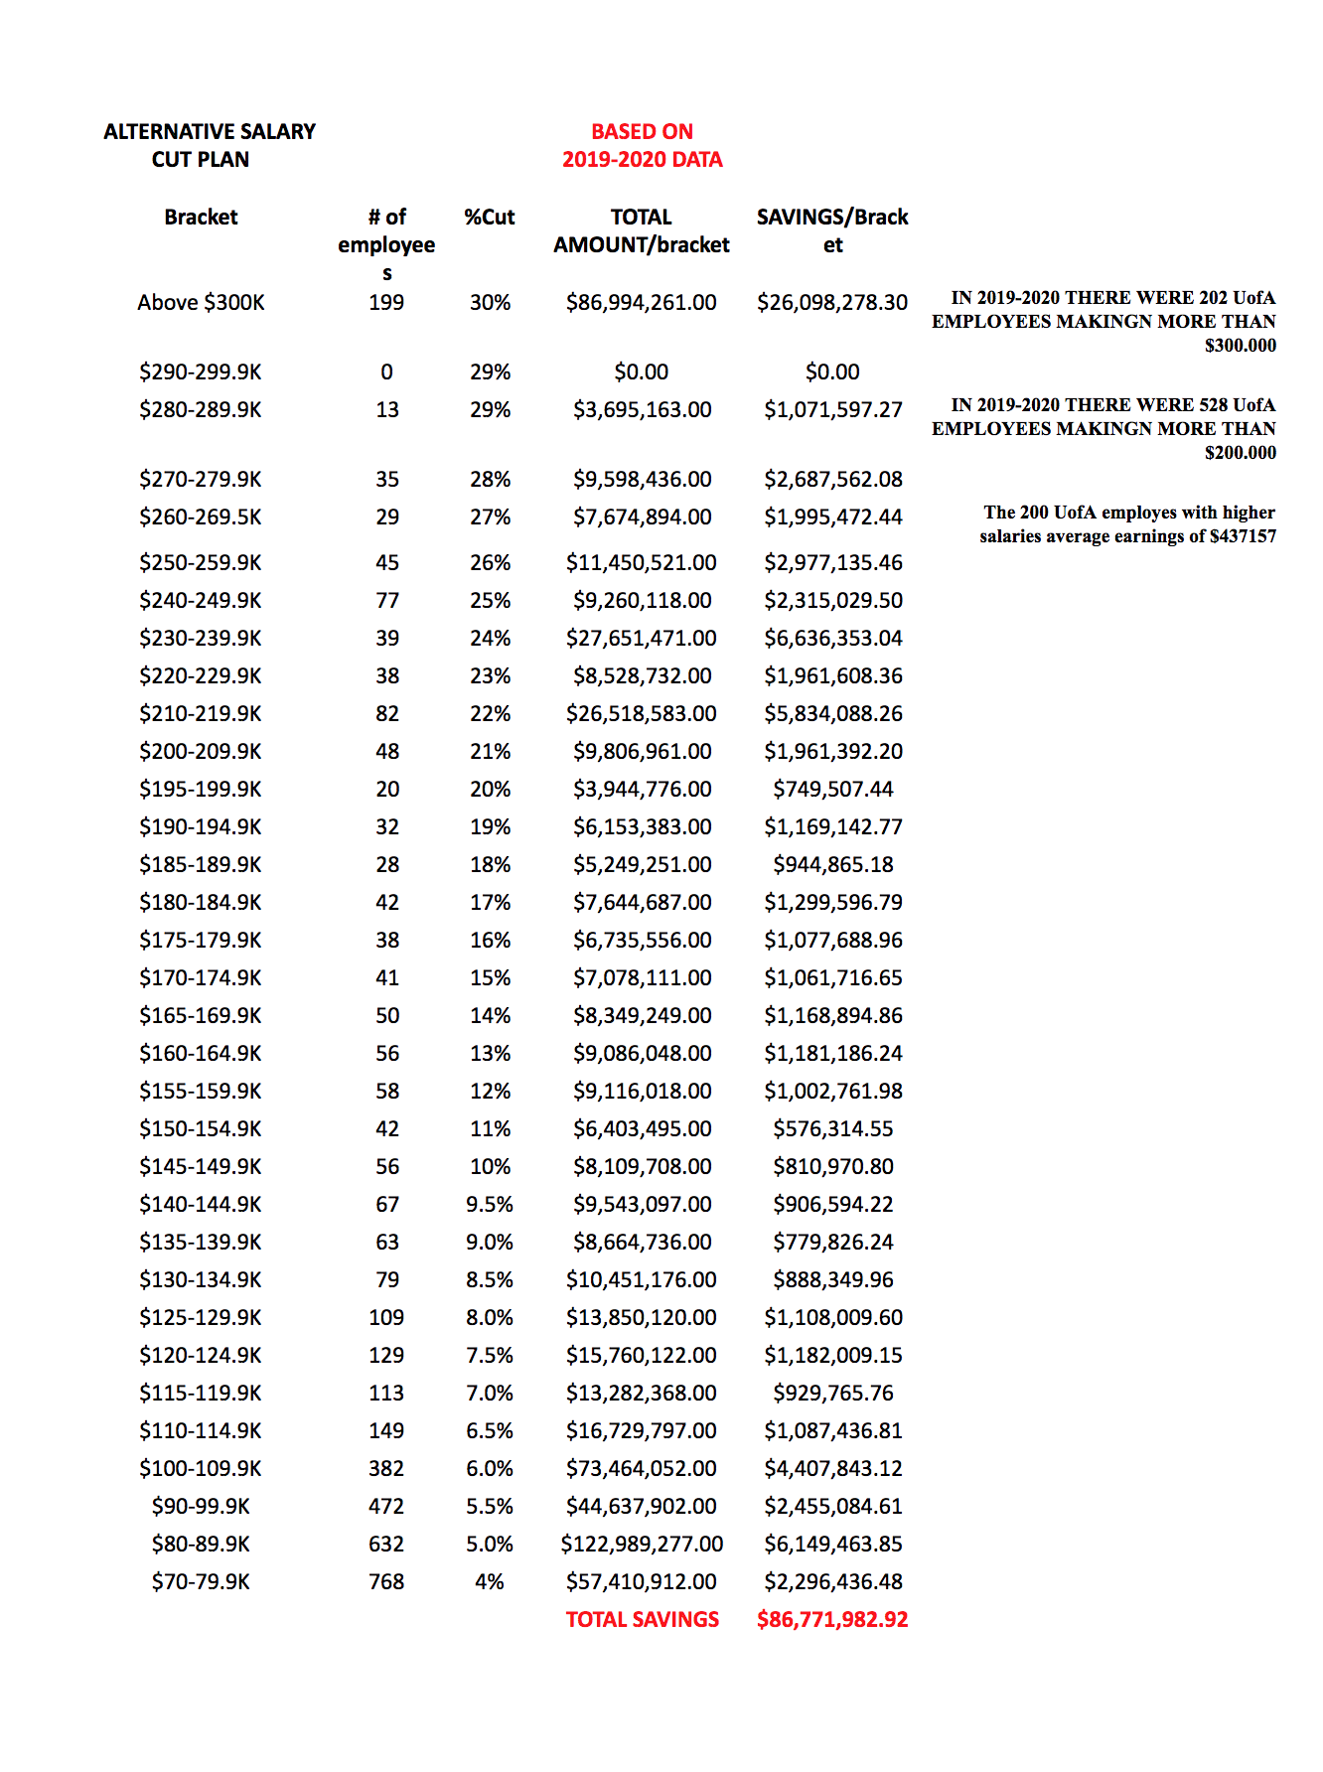
The simple Top Down Plan would yield savings of $86,771,983*
The current Bottom Up Plan aims to save $93,000,000, although data and method have not been shared.
How much do we actually need to save? Why? For what? Data and metrics please.
*The salary data used for this analysis is the most recent available one, based on 1.0 FTE and a 12 months salary equivalent for academic employees.

Slide 7
In our Top Down plan
Employees making less than $70K would not take a pay cut
The largest brackets of employees would contribute no more than 5% of their salaries, in line with peer institutions, rather than the extraordinary 15% in the current Bottom Up plan
High earners would have bracketed cuts proportional to their state funded base salaries

Slide 8
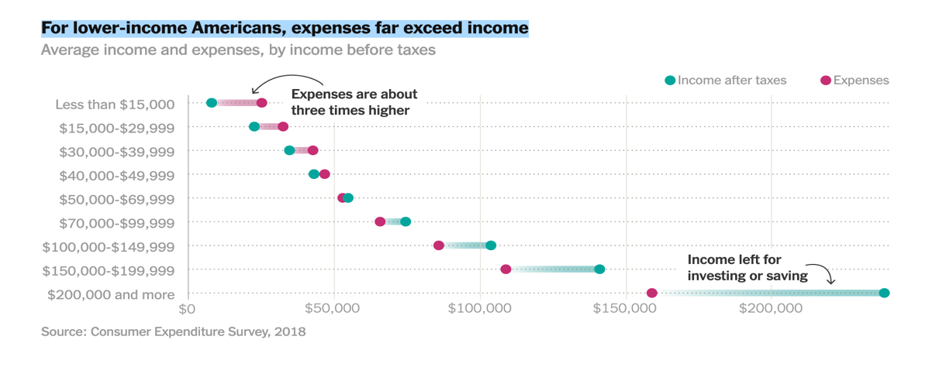
Why we need a higher pay cut floor
Employees whose salaries are below $70K are disproportionately affected by financial emergencies, while people whose salaries are above $200K have an extraordinary financial advantage over the rest of the population in order to survive a pandemic. (The New York Times (4/23/20 “Who Has Enough Cash to Get Through the Coronavirus Crisis?” https://www.nytimes.com/interactive/2020/04/23/opinion/emergency-savings-coronavirus.html)

Slide 9
Why we need a higher cap
In 2019 the U of A had 532 people
making more than $200K.
Their average salary was $313,639
In addition to financial security, some enjoy enhanced retirement and tax benefits not shared by most employees

Slide 10
Why we need access to the data
A well constructed plan needs accurate data, expert design, and stakeholder review
A public university needs transparency, accountability and shared governance

Slide 11
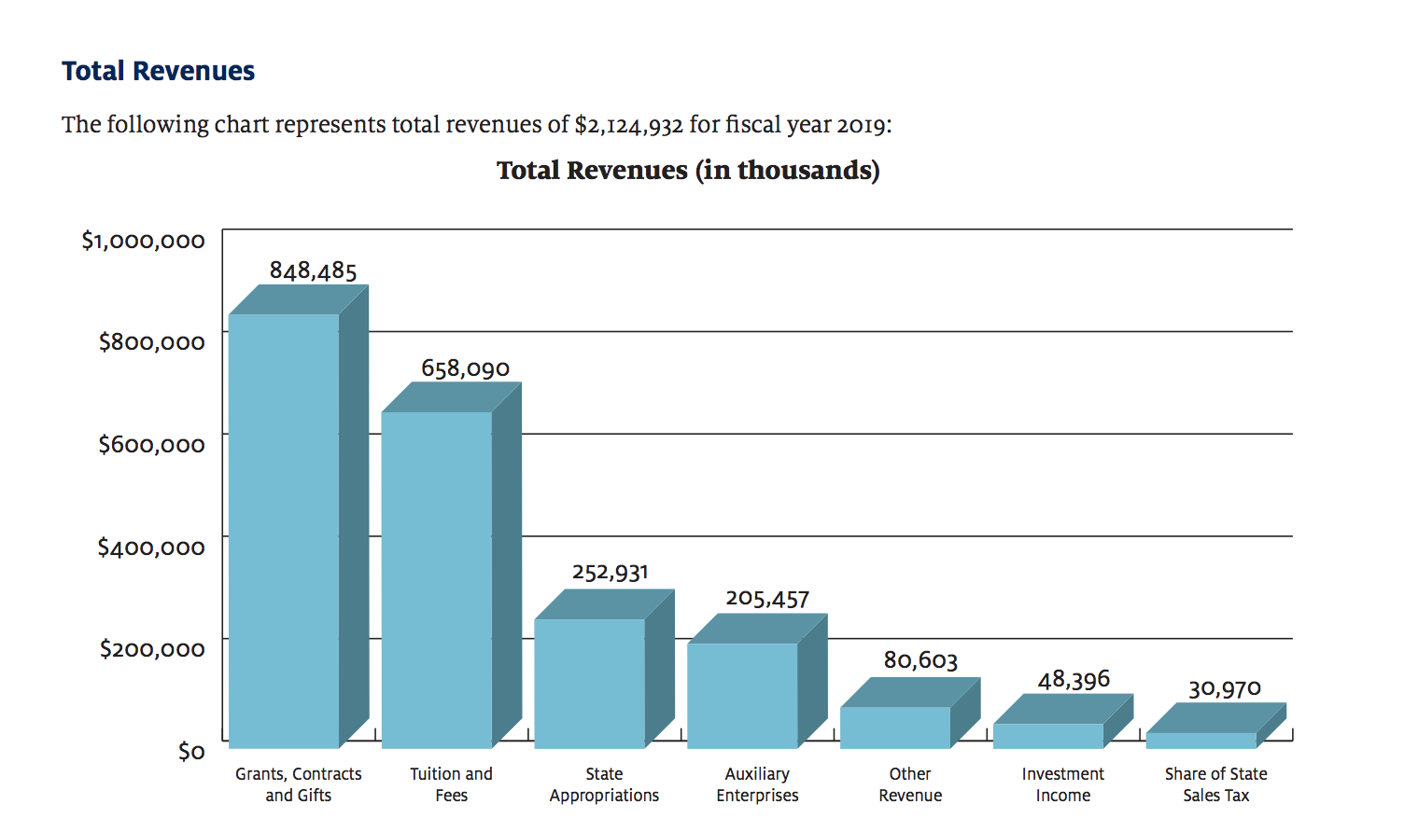
Access to data would help us craft a better, fairer plan
A better plan would recognize that many
high earning faculty
contribute up to 65% of the University’s operating budget through research grants
From the 2019 Comprehensive Annual Review of Finances p. 25

Slide 12
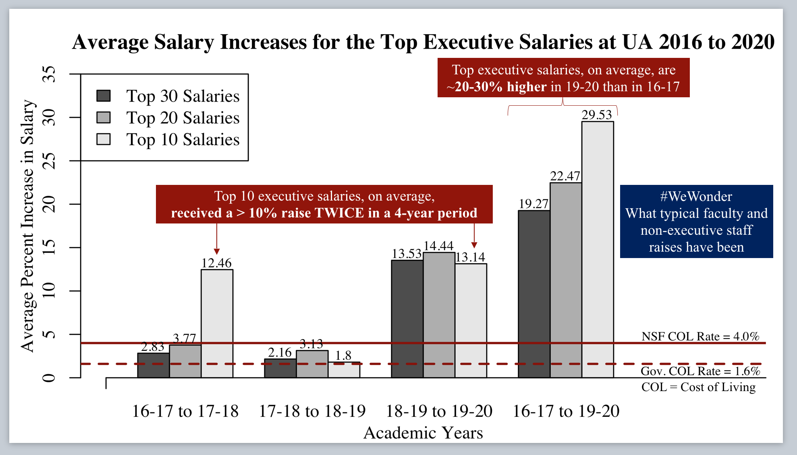
An even better plan would concentrate the high end pay cuts in administration where executive compensation packages have increased 20-30% in the last four years...

Slide 13
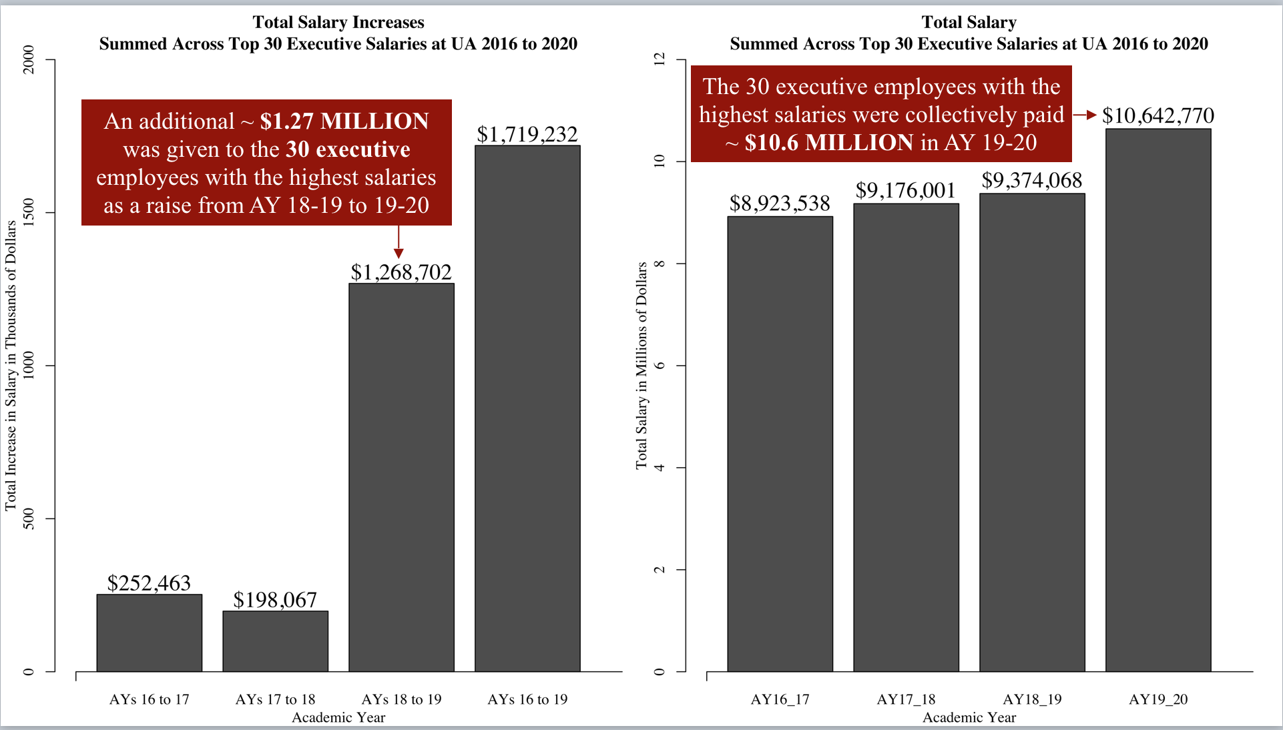
Totalling about
$10.6 million
in salaries in 2019-2020
for the top 30 executive positions*
*including President Of The University, Senior Vice President, Academic Affairs-Provost, Senior Vice President, Chief Marketing/Communications Officer, Senior Vice President And Chief Financial Officer, Business Affairs, Senior Vice President, Senior Associate To The President / Secretary Of The University, Associate Vice President, Vice President, Innovation - Office For Research And Discovery, Vice President For Research
Senior Vice President, Legal Affairs/General Counsel, Vice Provost, Global Affairs, Associate Vice President, Community Engagement
Vice President, Information Strategy - University Libraries, Vice President, Academic Initiatives - Student Success, Assistant Vice President, Research Administration, Vice Provost, Inclusive Excellence, Vice President, Business Affairs And Human Resources, Assistant Vice President, Tech Launch Arizona, Assistant Vice President / Chief Operating Officer, Vice President, University Planning / Design And Operations, Vice President, Strategic Business Initiatives, Associate Vice President, Research, Assistant Vice President, Operations, Vice President, Enrollment Management / Student Affairs Advancement Associate Vice President, Global Initiatives Associate Vice President, Research Assistant Vice President / Chief Of Staff, Operations And Planning Vice Provost/Dean, Graduate Educ.Graduate College Admin

Slide 14
….as our institutional financial position has deteriorated

Slide 15
Compassion
Integrity
Core Mission
Teaching, Research,
And Community Service

Slide 16
#Bearing Down

